Slide 1
Architecture Components
Elvedin Selimoski

Slide 2
ViewModel
Repository
LiveData
Lifecycle

Slide 3
Architecture Components
A set of Android libraries for structuring your app in a way that is robust, testable, and maintainable.

Slide 4
Architecture Components
Consist of best architecture practices + libraries
Encourage recommended app architecture
A LOT LESS boilerplate code
Testable because of clear separation
Fewer dependencies
Easier to maintain

Slide 5
Overview
UI Controller
(activity/fragment)
Displays data and forwards on UI events
UI is notified of changes using observation
ViewModel
Holds all the data needed for the UI
LiveData
LiveData
LiveData
Single source of truth for all app data; clean API for UI to communicate with
Repository
RoomDatabase
LiveData
LiveData
Manages local data SQLite data source, using objects
Entity
SQLite
DAO

Slide 6
ViewModel
Elvedin Selimoski

Slide 7
ViewModel
View models are objects that provide data for UI components and survive configuration changes.
ViewModel
LiveData
LiveData
LiveData

Slide 8
ViewModel
Provides data to the UI
Survives configuration changes
You can also use a ViewModel to share data between fragments
Part of the lifecycle library

Slide 9



Survives configuration changes
Activity Instance
ViewModel
Rotation Event
Activity UI Data
Re-created Activity Instance

Slide 10

ViewModel serves data
ViewModel serves data to the UI
Data can come from Room database or other sources
ViewModel's role is to return the data, it can get help to find or generate the data

Slide 11

Best practice to use repository
Recommended best practice:
Use a repository to do the work to get the data
Keeps ViewModel as clean interface between app and data

Slide 12
Restaurant analogy
Customer requests meal from server
Server takes order to chefs
Chefs prepare meal
Server delivers meal to customer
UI requests data from ViewModel
ViewModel asks Repository for data
Repository gets data
ViewModel returns data to UI

Slide 13
ViewModel example using repository
public class WordViewModel extends AndroidViewModel {
private WordRepository mRepository;
private LiveData<List<Word>> mAllWords;
// Initialize the repository and the list of words
public WordViewModel (Application application) {
super(application);
mRepository = new WordRepository(application);
mAllWords = mRepository.getAllWords();
}

Slide 14
ViewModel example continued
LiveData<List<Word>> getAllWords() {
return mAllWords;
}
public void insert(Word word) {
mRepository.insert(word);
}
public void deleteWord(Word word) {
mRepository.deleteWord(word);
}

Slide 15
Do not pass context into ViewModel
Never pass context into ViewModel instances
Do not store Activity, Fragment, or View instances or their Context in the ViewModel
An Activity can be destroyed and created many times during the lifecycle of a ViewModel
If you need application context, inherit from AndroidViewModel

Slide 16
ViewModel does not survive app closure
ViewModel survives configuration changes, not app shutdown
ViewModel is not a replacement for onSaveInstanceState()
(if you are not saving the data with Room)
See Saving UI States

Slide 17
Repository
Elvedin Selimoski

Slide 18
Repository
Best practice, not part of Architecture Components libraries
Implement repository to provide single, clean API to app data
Repository

Slide 19
Repository fetches or generates data
Use repository to fetch data in the background
Analogy: chefs prepare meals behind the scenes

Slide 20
Multiple backends
Repository
Potentially, repository could manage query threads and allow you to use multiple backends
Example: in Repository, implement logic for deciding whether to fetch data from a network or use results cached in the database
Dao
Network

Slide 21
Repository example
public class WordRepository {
private WordDao mWordDao;
private LiveData<List<Word>> mAllWords;
WordRepository(Application application) {
WordRoomDatabase db = WordRoomDatabase.getDatabase(application);
mWordDao = db.wordDao();
mAllWords = mWordDao.getAllWords();
}
[... more code…]
}

Slide 22
Get and insert data
LiveData<List<Word>> getAllWords() {
return mAllWords;
}
// Must insert data off the main thread
public void insert (Word word) {
new insertAsyncTask(mWordDao).execute(word);
}
[... more code…]
}

Slide 23
Insert off main thread
private static class insertAsyncTask extends AsyncTask
<Word, Void, Void> {
private WordDao mAsyncTaskDao;
insertAsyncTask(WordDao dao) {
mAsyncTaskDao = dao;
}
@Override
protected Void doInBackground(final Word... params) {
mAsyncTaskDao.insert(params[0]);
return null;
}
}

Slide 24
LiveData
Elvedin Selimoski

Slide 25
LiveData
LiveData is a data holder class that is aware of lifecycle events. It keeps a value and allows this value to be observed.
ViewModel
LiveData
LiveData
LiveData
Use LiveData to keep your UI up to date with the latest and greatest data.

Slide 26

LiveData
LiveData is observable data
Notifies observer when data changes
Is lifecycle aware:
knows when device rotates
or app stops

Slide 27

Use LiveData to keep UI up to date
Create an observer that observes the LiveData
LiveData notifies Observer objects when the observed data changes
Your observer can update the UI every time the data changes

Slide 28
Creating LiveData
To make data observable, return it as LiveData:
@Query("SELECT * from word_table)
LiveData<List<Word>> getAllWords();

Slide 29



Using LiveData with Room
Room generates all the code to update the LiveData when the database is updated

Slide 30
Passing LiveData through layers
When you pass live data through the layers of your app architecture, from a Room database to your UI, that data must be LiveData in all layers:
DAO
ViewModel
Repository

Slide 31
Passing LiveData through layers
DAO:
@Query("SELECT * from word_table")
LiveData<List<Word>> getAllWords();
Repository:
LiveData<List<Word>> mAllWords =
mWordDao.getAllWords();
ViewModel:
LiveData<List<Word>> mAllWords =
mRepository.getAllWords();

Slide 32
Observing LiveData
Create the observer in onCreate() in the Activity
Override onChanged() in the observer to update the UI when the data changes
When the LiveData changes, the observer is notified and its onChanged() is executed

Slide 33
Observing LiveData: example
final Observer<String> nameObserver =
new Observer<String>() {
@Override
public void onChanged(@Nullable final String newName) {
// Update the UI, in this case, a TextView.
mNameTextView.setText(newName);
}
};
mModel.getCurrentName().observe(this, nameObserver);

Slide 34
No memory leaks
Observers are bound to Lifecycle objects which are objects that have an Android Lifecycle
Observers clean up after themselves when their associated lifecycle is destroyed

Slide 35
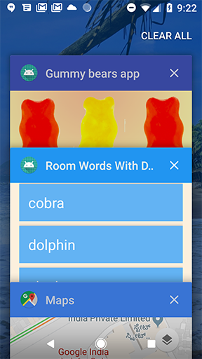
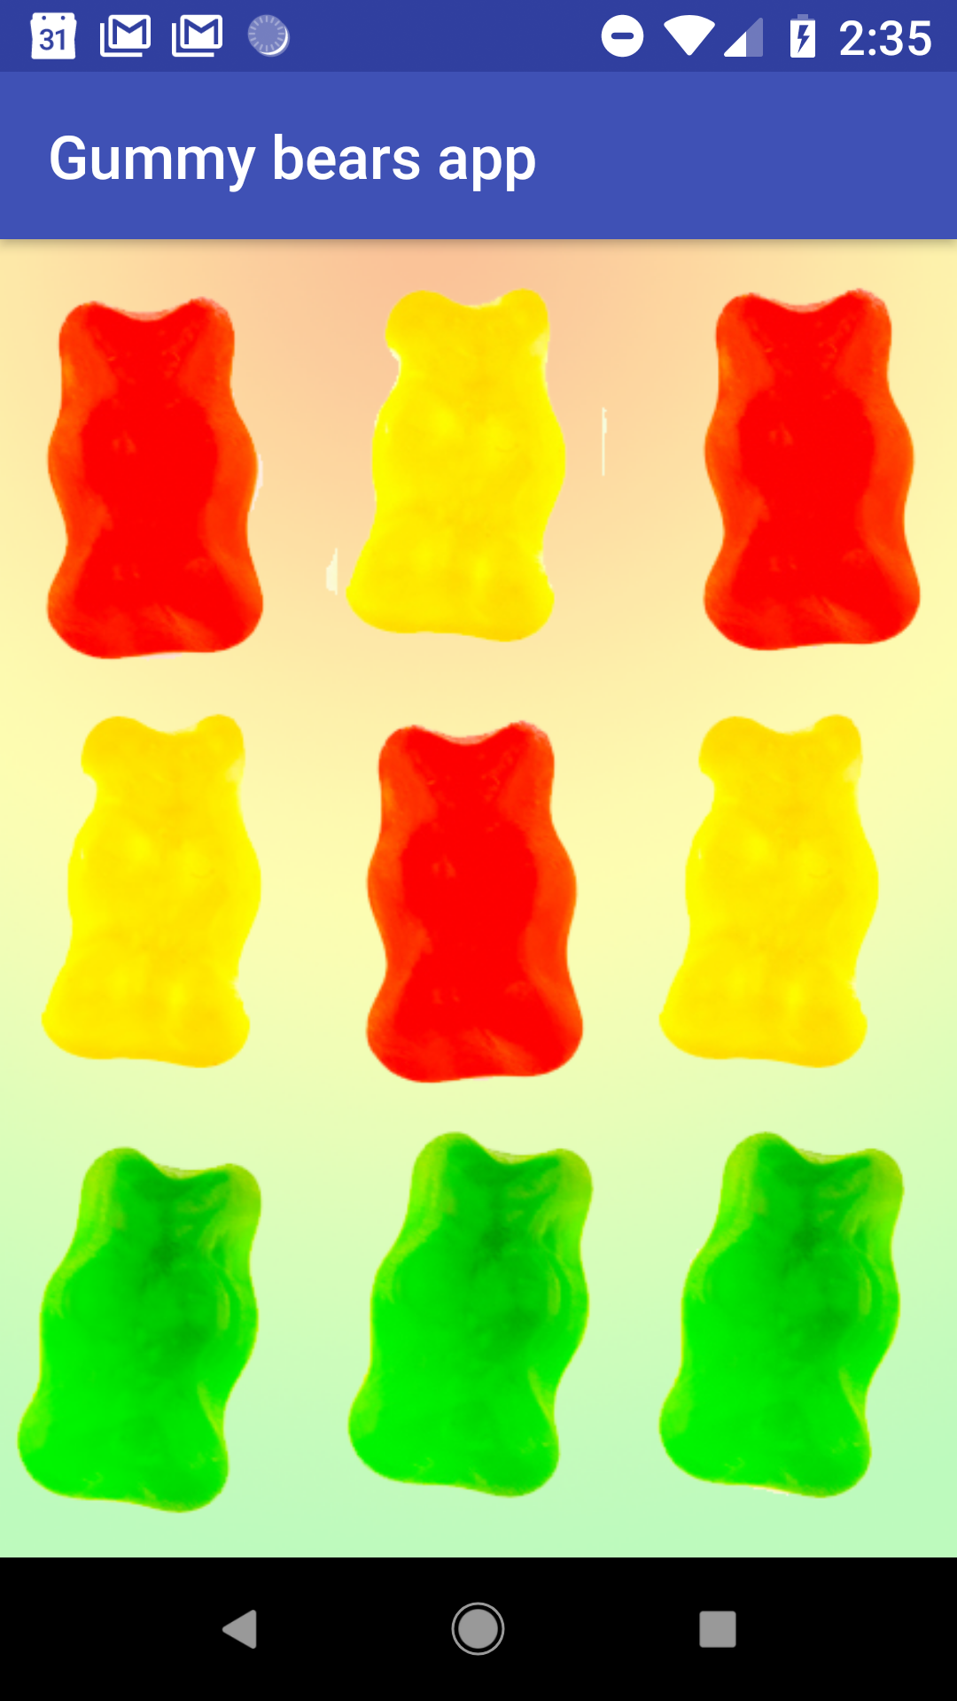
LiveData is always up to date
If a lifecycle object becomes inactive, it gets the latest data when it becomes active again
Example: an activity in the background gets the latest data right after it returns to the foreground

Slide 36
LiveData handles configuration changes
If an activity or fragment is re-created due to a configuration change such as device rotation, the activity or fragment immediately receives the latest available data

Slide 37
Share resources
You can extend a LiveData object using the singleton pattern, for example for services or a database
The LiveData object connects to the system service once, and then any observer that needs the resource can just watch the LiveData object
See Extend LiveData

Slide 38
Lifecycle
Elvedin Selimoski

Slide 39
Lifecycle-aware components
Instead of managing lifecycle-dependent components in the activity's lifecycle methods, onStart(), onStop(), and so on, you can make any class react to lifecycle events

Slide 40
Lifecycle-aware components
Lifecycle-aware components perform actions in response to a change in the lifecycle status of another component
For example, a listener could start and stop itself in response to an activity starting and stopping

Slide 41
Use cases
Switch between coarse and fine-grained location updates depending on app visibility
Stop and start video buffering
Stop network connectivity when app is in background
Pause and resume animated drawables

Slide 42
Lifecycle library
Import the android.arch.lifecycle package
Provides classes and interfaces that let you build lifecycle-aware components that automatically adjust their behavior based on lifecycle state of activity or fragment
See Handling Lifecycles with Lifecycle-Aware Components

Slide 43
LifecycleObserver interface
LifecycleObserver has an Android lifecycle.
It does not have any methods, instead, uses OnLifecycleEvent annotated methods.

Slide 44
@OnLifecycleEvent
@OnLifecycleEvent indicates life cycle methods
@OnLifecycleEvent(Lifecycle.Event.ON_START)
public void start() {...}
@OnLifecycleEvent(Lifecycle.Event.ON_STOP)
public void start() {...}
See Lifecycle.event reference for more lifecycle events

Slide 45
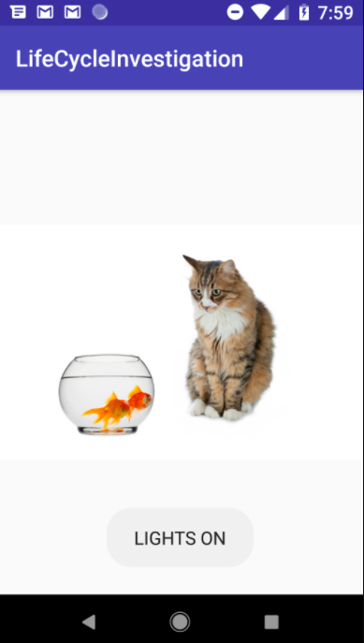
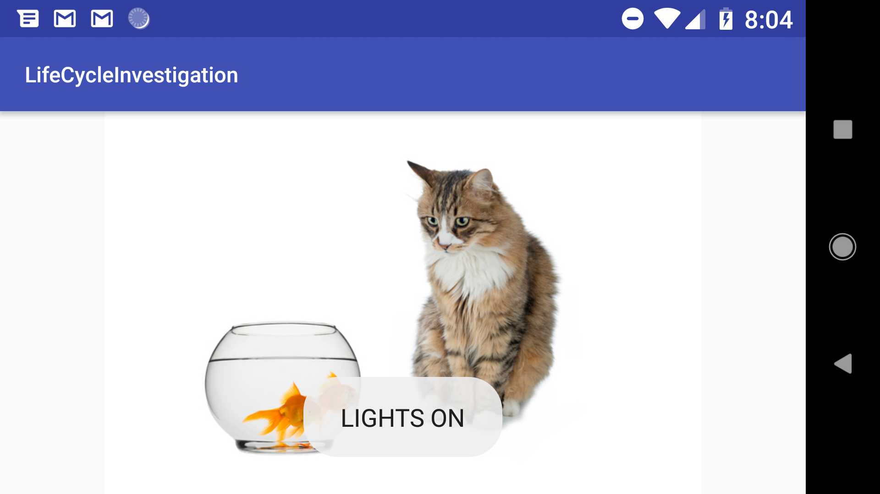
POJOs can be life cycle aware
You can make any class react to lifecycle events
In these pictures, the Toast is created by a plain old Java class when app starts or device rotates

Slide 46
Adding lifecycle awareness to a POJO
public class Aquarium {
// Constructor takes Application and lifecycle
public Aquarium(final Application app,
Lifecycle lifecycle) {
...
}

Slide 47
Constructor for lifecycle aware POJO
public Aquarium(final Application app, Lifecycle lifecycle) {
// Add a new observer to the lifecycle.
lifecycle.addObserver(new LifecycleObserver() {
@OnLifecycleEvent(Lifecycle.Event.ON_START)
public void start() {
Toast.makeText(app, "LIGHTS ON", Toast.LENGTH_SHORT).show();
}
});
}

Slide 48
Creating an instance
public class MainActivity extends AppCompatActivity {
private Aquarium myAquarium;
protected void onCreate(...) {
...
// Create aquarium.
// Pass context and this activity's lifecycle
myAquarium = new Aquarium(this.getApplication(),
getLifecycle());
}
}

Slide 49
END

